Slide 1
NE 763: Advanced Reactor Materials
Fall 2026
Dr. Benjamin Beeler

Slide 2
Last Time
Radiation effects in SiC
Different defect regimes, leading to different swelling regimes
Point defect swelling saturates; void swelling does not
Point defect accumulation can directly be related to both swelling and thermal resistivity -> allows for indirect thermal conductivity determination
Voids don’t degrade the thermal conductivity as much as point defects
Pd SiC corrosion, forming various intermetallics
Started on graphite
anisotropy of crystal structure and properties
Mrozowski cracks
lots of texture and lots of porosity in bulk graphite

Slide 3
RADIATION EFFECTS IN GRAPHITE

Slide 4


Graphite Shrinkage
When graphite components are irradiated in a reactor, significant changes to their dimensions and properties occur
The unit of irradiation exposure EDND used in the figures is particular to nuclear graphite technology
EDND = Equivalent DIDO Nickel Dose
EDNF = Equivalent DIDO Nickel Flux
They are based upon the equivalent nickel activation in the DIDO reactor

Slide 5
Graphite Shrinkage
Graphite typically shrinks with dose until a point is reached where the shrinkage stops, and the graphite starts to swell
This change from shrinkage to swelling is known as "turnaround”
Due to the manufacturing process of nuclear graphite, the graphite component has a much lower density than may be expected (1.7-1.9 g/cm3) compared with 2.2.6 g/cm3 for pure graphite crystals
The original state of the graphite, and the particular radiation defects in graphite, govern this fluence-dependent behavior

Slide 6
Graphite Dimensional Change
Dimensional change data obtained on AGR graphite samples are shown at the right
The higher the temperature the sooner ‘turnaround’ from shrinkage to swelling occurs
This behavior is typical for most semi-isotropic, medium and fine-grained graphite grades, although the magnitude of the changes varies from grade to grade
Nuclear graphite, such as Gilsocarbon, is semi-isotropic
Anisotropic graphite can display significantly different irradiation behavior

Slide 7
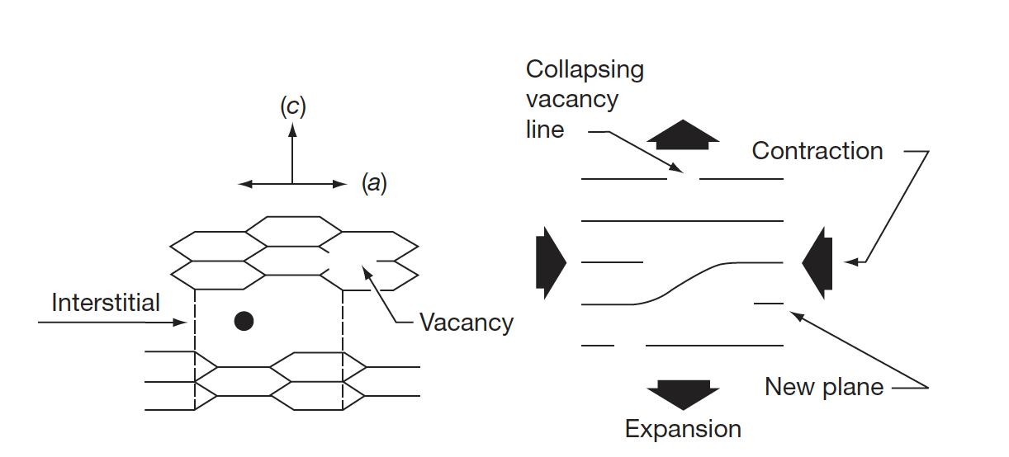
Interstitials in Graphite
The interstitial atom prefers to form a bridge-like structure on the graphene surface
Repelling the two graphene sheets increases c, yielding a corresponding contraction in a
Vacancies shrink the basal plane, further reducing a
Turnaround occurs when the matrix can no longer accommodate the defect-induced dimensional change

Slide 8
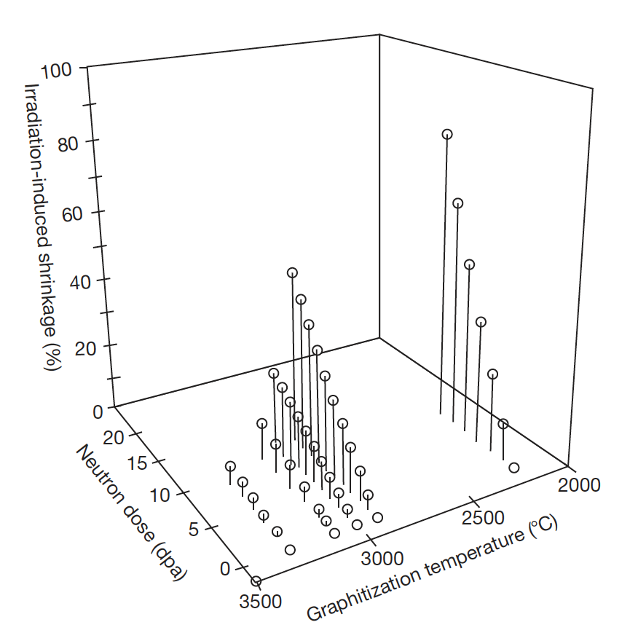
Graphite Shrinkage
Nuclear graphite possess a polycrystalline structure, usually with significant texture resulting from the method of forming during manufacture
Thermal shrinkage cracks that occur during manufacture and that are preferentially aligned in the crystallographic a-planes will initially accommodate the c-direction expansion
So, contraction in the a-direction will be observed, and graphite thus undergoes net volume shrinkage
With increasing dose, the crystallite dimensional changes fill in the porosity, and the volume shrinkage rate falls, eventually reaching zero
The graphite now begins to swell at an increasing rate with increasing neutron dose

Slide 9
Graphite Irradiation Under Loading
If graphite is irradiated under load the dimensional change data are modified
The difference between loaded and unloaded dimensional change is referred to as creep
The shrinkage is increased under compression and reduced under tension
With increasing fluence the creep strain increases fairly linearly at first, and then the rate reduces before finally increasing (looks similar to creep vs time plot, but not the same)

Slide 10
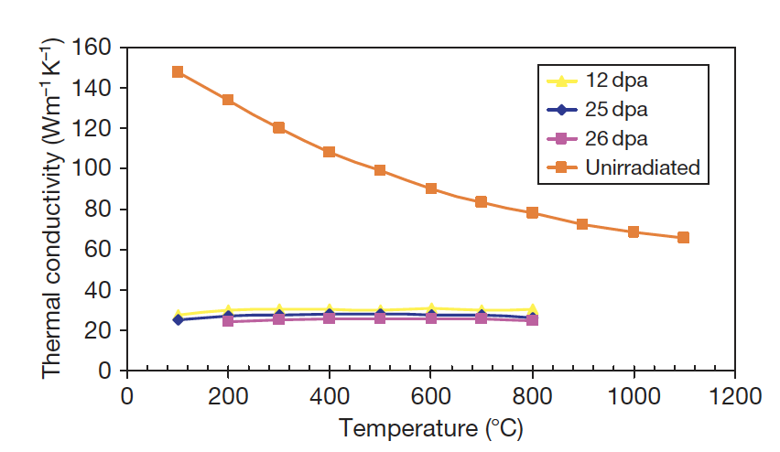
Thermal Conductivity
Graphite is a phonon conductor of heat
Similar to SiC, larger grain size, theoretical densities, low defect content, improve k
The increase of thermal resistivity due to irradiation damage has been ascribed to the formation of (1) small interstitial clusters, (2) vacancies, (3) vacancy loops
At any irradiation temperature, the decreasing thermal conductivity will reach a ‘saturation limit’

Slide 11
Impacts of Changes Under Irradiation
In graphite moderated reactors, the graphite structure provides channels for fuel, fuel-cooling, and control rod entry, the structural integrity of the graphite components is important from safety and lifetime considerations
Components develop stresses which need to be accounted for
Temperature distribution across a graphite channel is shown at the right
Fluence also changes radially
Fuel is in the center (bore)

Slide 12
Impacts of Changes Under Irradiation
Properties and dimensions change as a function of both temperature and fluence
First, the graphite brick will shrink faster at the bore than at the outside, and properties will vary radially
Graphite brick internal shrinkage and thermal stresses are generated; first tensile at the bore and compressive at the outside, and then reversing in sign towards the end of reactor life
Fortunately, much of this stress is reduced by irradiation creep

Slide 13
Impacts of Changes Under Irradiation
Discontinuities in the figure are due to shutdowns every 2 years
The difference in CTE between the inside and the outside of the brick, along with irradiation creep, causes the stresses to significantly change when the reactor is shutdown and the graphite cools
The change in stress at shutdown is mainly due to the temperature difference across the brick, which creeps out during reactor operation
Towards the EOL, we see significantly different stress states for the inside/outside of the graphite brick than at BOL

Slide 14

Irradiation Creep
Graphite will undergo creep during neutron irradiation and under stress at temperatures where thermal creep is generally negligible
Creep is so fundamentally important to graphite that if irradiation-induced stresses in graphite moderators could not relax via radiation creep, rapid core disintegration would result
One study showed that a 50% decrease in the assumed creep strain resulted in a 50% increase in the predicted hoop stress in a hollow cylindrical core brick
The total strain, in a graphite component under irradiation in a reactor core is given by:
where ε_{e} is the elastic strain; ε_{t}, the thermal strain; ε_{d}, the dimensional change strain; and ε_{c} is the creep strain

Slide 15
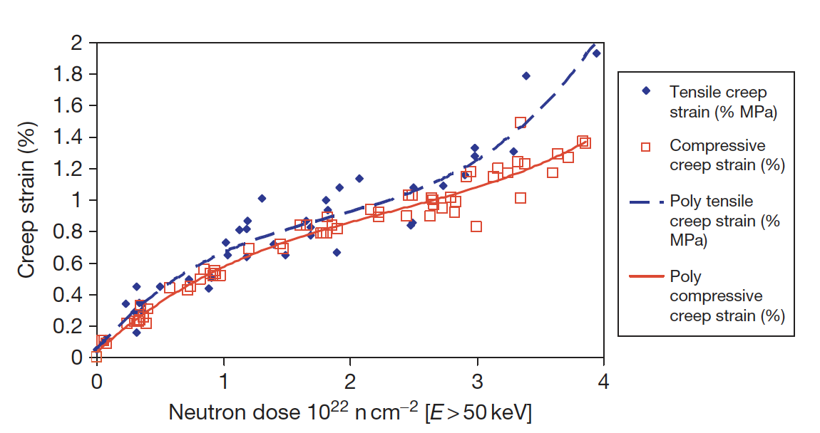
Irradiation Creep
Because of the significance of irradiation-induced creep to the stress levels in graphite core components, accurate models of creep have long been sought, but current models tend to break down at high temperature and fluence
Stress state (compressive/tensile) has an impact on the creep rate
The creep rate increases more rapidly in the tensile loading case compared to the compressive case at high dose

Slide 16
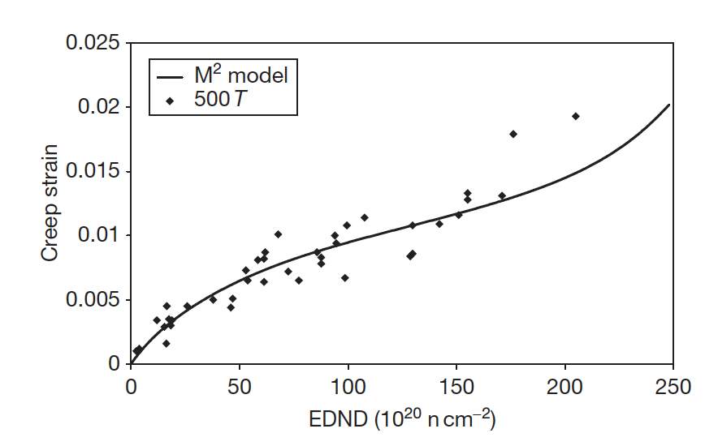
Irradiation Creep Models
Since creep is so important to graphite, a number of creep prediction models have been developed:
Linear viscoelastic creep, UK creep, Kennedy, Kelly and Burchell, etc.
These models can take into account evolving pore structure, thermal expansion, recoverable strain, etc.
The M² model potentially performs the most accurately as a function of dose at relatively low temperatures
However, no model is sufficiently accurate at both high dose and high temperature

Slide 17
Irradiation Creep
Irradiation-induced basal plane dislocation pinning/unpinning in the graphite crystal is the expected mechanism for the irradiation-induced creep
The pinning points are speculated to be interstitial atom clusters
The interstitial clusters are temporary barriers as they are destroyed by further irradiation
The concentration of pinning sites increases under irradiation from the initial value to a steady-state concentration
The initial creep rate is high and decreases to a near steady-state value as the pinning concentration saturates at a level controlled by the neutron flux and temperature
At high dose, the creep rate can again increase because of (1) high internal stress enhancing the creep rate, and (2) the destruction of interstitial pins by thermal diffusion of vacancies

Slide 18
CTE and Young’s Modulus
The behavior of the CTE and E is complex and differs between anisotropic and semi-isotropic grades
The CTE of Gilsocarbon first increases then reduces
For E there an increase with increasing fluence for Gilsocarbon
If irradiated past turnaround, significant degradation occurs, and the modulus starts to reduce
PGA = Pile Grade A, course, anisotropic graphite
PGA
Gilsocarbon

Slide 19
Summary
Graphite has a lot of texture and porosity, dependent upon fabrication
Graphite has anisotropic properties, but nuclear-grade graphite is manufactured in a way to target semi-isotropic properties
Graphite shrinks, then undergoes turnaround
This behavior is governed by point defects, which induced swelling, and close Mrozowski cracks
Turnaround happens quicker at higher temperatures, and is dependent upon applied stress
Irradiation creep is critically important in graphite

Slide 20
TRISO Fuel Failures

Slide 21
Fuel Failure Mechanisms
Overpressure
During irradiation, fission gases are released from the kernel into the porous buffer layer. The pressure that is generated exerts tensile forces on the SiC layer of the particle
For UO2 kernels, there is also excess oxygen released during fission which will react with carbon from the buffer to form CO and CO2 gas
Particles are generally sized with a large enough buffer void volume to ensure that they do not fail by overpressure during irradiation
Particle failure is postulated to occur as a result of an insufficient or missing buffer layer that occurs during the coating process

Slide 22
Fuel Failure Mechanisms
Irradiation-induced IPyC cracking
Under irradiation, pyrocarbon (PyC) shrinks in both the radial and tangential directions
This behavior puts the PyC layers into tension in the tangential direction
However, irradiation-induced creep works to relieve the tensile stress in the PyC layer
If the PyC is strongly attached to the SiC layer, the PyC shrinkage provides a strong compressive stress that offsets the tensile stresses generated by gas production in the kernel
High tensile loads, or insufficient creep, can lead to cracking of the IPyC

Slide 23
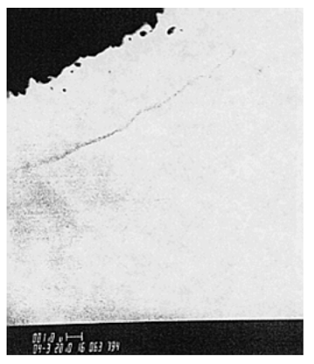
Fuel Failure Mechanisms
Debonding between IPyC and SiC
The debonding is related to the strength of the IPyC/SiC interface
Weakly bonded coating layers can partially detach because of the tensile stresses generated by the IPyC shrinkage under irradiation
A particle for which partial debonding of the IPyC from the SiC has occurred can develop relatively large tensile stresses in the SiC
Irradiation induced creep relieves the stress at longer times

Slide 24
Fuel Failure Mechanisms
Kernel migration (amoeba effect)
Kernel migration is defined simply as movement of the kernel toward the TRISO-coating, which can lead to the kernel penetrating the TRISO-coating
Kernel migration is associated with carbon transport in the particle in the presence of a temperature gradient
A thermal gradient generates different equilibrium conditions for C, UO2, CO and CO2 at either side of the particle
Carbon diffuses up the temperature gradient, the kernel diffuses down

Slide 25
Fuel Failure Mechanisms
Fission product attack
Fission products can be transported from the kernel to the inner surface of the SiC where they interact and can damage and potentially fail the SiC layer
Bigger issue in UC kernels
In UCO kernels, the oxycarbide form of the kernel generally ties up all but the noble fission products (e.g., Pd) as either carbides or oxides, which tend to limit their mobility in the UCO system
However, Pd and Ag transport have still been observed in UCO coated particle fuel

Slide 26
Fuel Failure Mechanisms
Matrix-OPyC interactions and OPyC irradiation-induced cracking
During manufacture, infiltration of the liquid graphitic matrix into the porosity of OPyC caused mechanical weakening
During subsequent dimensional change under irradiation this caused OPyC layer to fail by cracking and debonding from the SiC layer
This has largely been addressed through specifications on the matrix material and on the microstructure of the OPyC
Non-retentive SiC
There are situations where the SiC layer becomes functionally failed or degraded in some way and is no longer retentive of fission products
Diffusive release through intact layers
If fuel temperatures during normal operation approach 1300C, then some of the fission products that are usually retained by the TRISO coating (e.g., cesium) will be able to diffuse out of the particle during normal operation
SiC degradation resulting in permeability
Cesium attack of the SiC and/or CO corrosion of the SiC can allow fission products to be released at high burnup

Slide 27
Fuel Failure Mechanisms
Creep failure of PyC
Under stress, thermal creep of the PyC will occur
In some post-irradiation heating tests, photomicrographs reveal a thinning and failure of the PyC
Such failure has not led to failure of the SiC layer
SiC thermal decomposition
At very high temperatures (> 2000C) the SiC layer undergoes thermal decomposition
The phenomenon is primarily a function of temperature and time and has not played a major role in fuel failure at lower accident temperatures

Slide 28
Fuel Failure Mechanisms
Kernel-coating mechanical interaction (KCMI)
At sufficiently high burn-up values, it is inevitable that all gas gaps between the kernel and coatings will close, thereby resulting in a mechanical interaction between the two
Modelling studies predict that the SiC layer will fail shortly after the onset of KCMI
This failure mechanism could be of increasing importance as attempts are made to achieve higher burn-up values

Slide 29
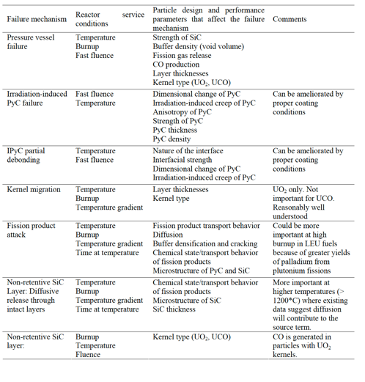
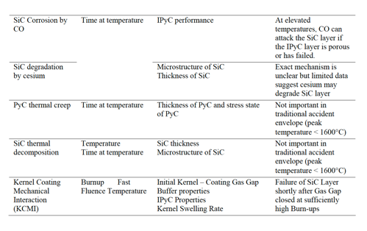
Fuel Failure Mechanisms

Slide 30
Fuel Failure Summary
Overpressure
IPyC cracking
IPyC and SiC debonding
Kernel migration
Fission product attack
Creep failure of PyC
SiC decomposition
KCMI
These failure mechanisms have been observed to some extent in TRISO-coated fuel testing activities conducted around the world
They are in general functions of temperature, burnup, fluence, and temperature (gradient) in the particle and details of the particle design
TRISO-coated fuel is usually designed such that none of the fuel failure mechanisms are expected to be significant

